Slide 1
SMS Platform
Focus
Goal
How to capture new insights
by integrating heterogeneous data sources in the domain of Science Technology and Innovation?
Semantically Mapping Science (SMS) Platform: http://sms.risis.eu
Notes:
Good morning to all of you.
I would like to start off with this question:
Scientometrics has been dominated strongly by large bibliographic datasets like WoS and more recently Scopus.
Yes, these datasets are very large. Yet, there is a catch. They restricts research to a small set of variables.
To do richer studies, one needs to combine traditional scientometric data with other relevant datasets.
I am sure many of you went through the paint of integrating heterogenous datasets.
Often, the resulting integration model is defined for one specific task. Which makes it less reusable or I would say, not reusable.

Slide 2
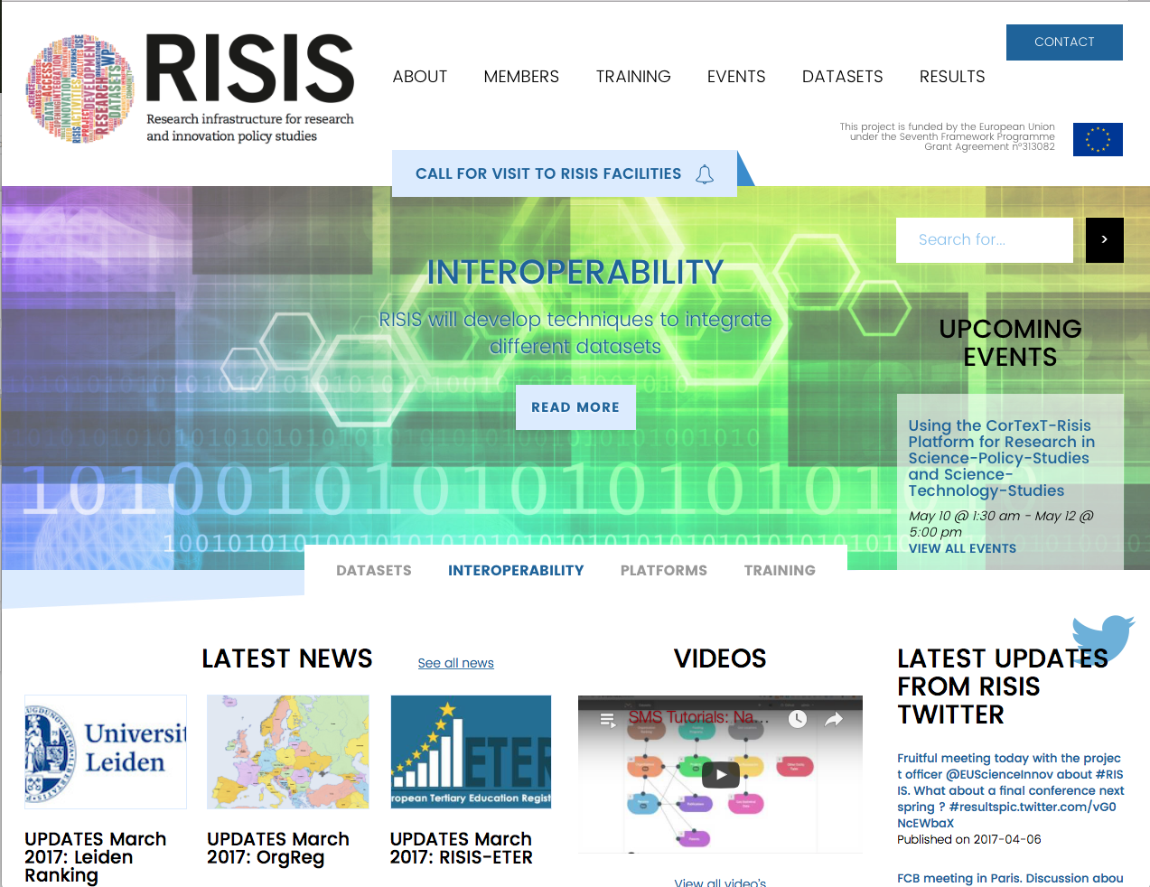
RISIS Project
risis.eu
Jan 2014
May 2017
Jan 2018
Semantically Mapping Science (SMS) Platform: http://sms.risis.eu
Notes:
7 universities and 6 research institutes from 10 European countries Joined forces to tackle that very same problem in a project name RISIS..
RISIS is a 4 years EU project that started in January 2014 and is almost at its end..

Slide 3
RISIS Project
risis.eu
build a distributed
research infrastructure
to advance Science,
Technology & innovation
studies.
Semantically Mapping Science (SMS) Platform: http://sms.risis.eu
Notes:
The goal of RISIS is to build a distributed research infrastructure to advance Science, Technology & innovation studies.
By now, … I guess you guys cannot wait t find out how RISIS addressed the problem of integrating heterogenous data in a flexible and reusable way?
ild a distributed Researcrh Infrastructure to advance STI studies.

Slide 4
Enriching Scientometrics with Linked Data
Semantically Mapping Science (SMS) Platform
Ali Khalili, Al Idrissou, Peter van den Besselaar*, Klaas Andries de Graaf, Antonis Loizou,
Stefan Schlobach and Frank van Harmelen
*Department of Organization Sciences, Faculty of Social Science
Department of Computer Science, Faculty of Sciences
, Fac, d
Notes:
I am Al Idrissou from the VU University Amsterdam,
On the behalf of my college Ali Khalili,
I am very happy to stand before you today to present SMS a Semantically mapping science Platform that links and enriches data for studying science.
The next slides will briefly introduce the 4 architecture pillars of SMS and some of its services and applications

Slide 5
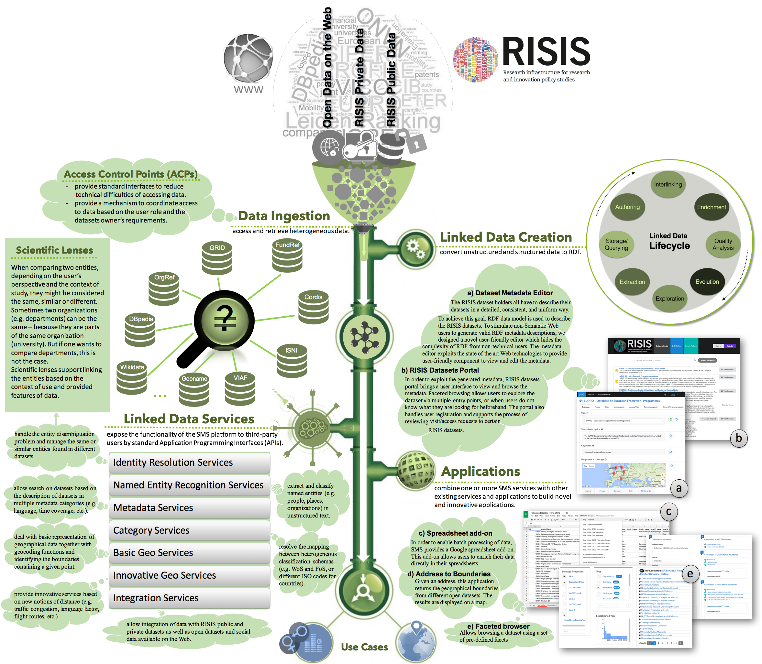
SMS Platform
Data
Architecture
Semantically Mapping Science (SMS) Platform: http://sms.risis.eu

Slide 6
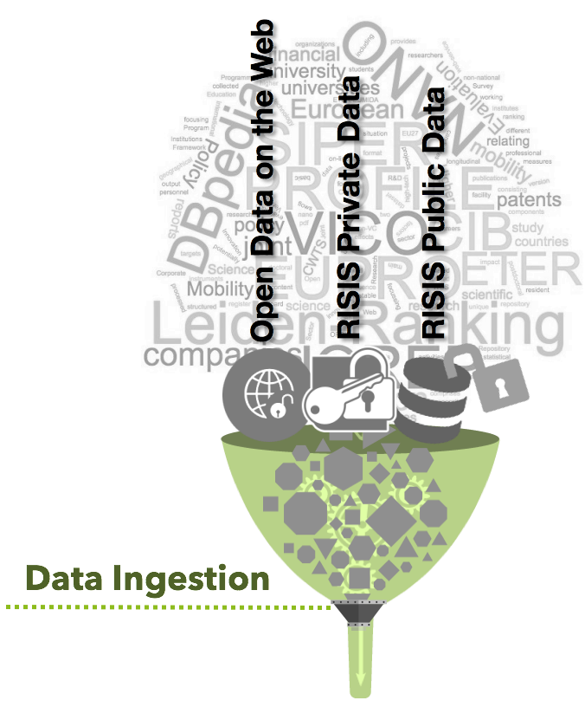
SMS Platform
Data Ingestion
Semantically Mapping Science (SMS) Platform: http://sms.risis.eu
Notes:
WHAT TO CONSIDER IN ORDER TO INGEST THE DATA

Slide 7
SMS Platform
Data Ingestion
Access level
Identifying the data access policies
i.e. Who can access what parts of the data.
Semantically Mapping Science (SMS) Platform: http://sms.risis.eu
Notes:
ACPs

Slide 8
SMS Platform
Data Ingestion
Format
Structure
Identifying the format and structure of the data
Semantically Mapping Science (SMS) Platform: http://sms.risis.eu
Notes:
ACPs

Slide 9
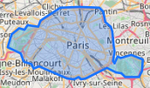
SMS Platform
Linked
Entities
University Organisation Geo-data
Identifying the entity types covered by the data
Semantically Mapping Science (SMS) Platform: http://sms.risis.eu
Notes:
WITHIN RISIS, WE IDENTIFIED THESE TYPES OF ENTITIES
Result of our technical interoperability report
Can Add New Entity Types -> e.g. adding Organization Ranking

Slide 10
SMS Platform
Linked
Entities
Conceptual Model: Entity Types
Organization
Rankings
Funding
Programs
Geo
LoCations
Organizations
Projects
Geo
Boundaries
Persons
Publications
Geo
Statistical
Data
Patents
Other
Entity Types
Semantically Mapping Science (SMS) Platform: http://sms.risis.eu
Notes:
WITHIN RISIS, WE IDENTIFIED THESE TYPES OF ENTITIES
Result of our technical interoperability report
Can Add New Entity Types -> e.g. adding Organization Ranking

Slide 11
SMS Platform
Linked
Entities
Conceptual Model: Links
Organization
Rankings
Funding
Programs
Geo
LoCations
Organizations
Projects
Geo
Boundaries
Persons
Publications
Geo
Statistical
Data
Patents
Other
Entity Types
Semantically Mapping Science (SMS) Platform: http://sms.risis.eu
Notes:
AND LINKS AMONG THEM

Slide 12
SMS Platform
Linked
Entities
Conceptual Model: Geo-Links
Organization
Rankings
Funding
Programs
Geo
LoCations
Organizations
Projects
Geo
Boundaries
Geo
Geo
Persons
Publications
Geo
Statistical
Data
Geo
Patents
Other
Entity Types
Semantically Mapping Science (SMS) Platform: http://sms.risis.eu
Notes:
SOME OF THE ENTITIES ARE DESCRIBED WITH GEO INFORMATION WHICH ALLOWS THE DATA TO BE ENRICHED WITH DATA SUCH AS BOUNDARY OR GEO STATISTICS

Slide 13
SMS Platform
Data Ingestion
Entities
Organization
Rankings
Funding
Programs
Geo
LoCations
+
+
Organizations
Projects
Geo
Boundaries
Geo
Geo
Persons
Publications
Geo
Statistical
Data
Geo
Patents
Other
Entity Types
Identify the type of entities that your dataset covers.
Semantically Mapping Science (SMS) Platform: http://sms.risis.eu
Notes:
ACPs

Slide 14
SMS Platform
Linked Data
Creation
Basic (Syntactic) conversion
Semantically Mapping Science (SMS) Platform: http://sms.risis.eu

Slide 15
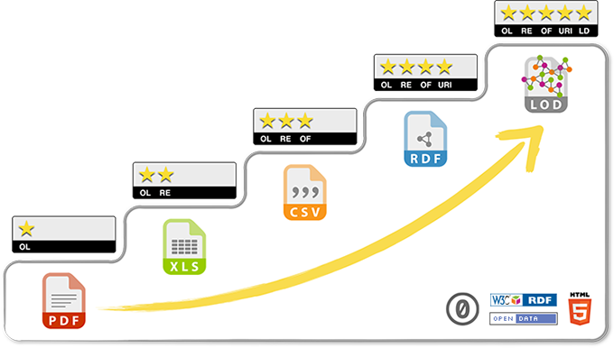
SMS Platform
Linked Data
Creation
Triple
(Subject-Predicate-Object)
Semantically Mapping Science (SMS) Platform: http://sms.risis.eu
Notes:
5 start open data
1 Open Licence: available on he web
2 Machine readable structure data
3 Non proprietary machine readable
4 Compatible with W3C syandard
5 Linked to other data
Stimulates to use non proprietary file format & link to other data

Slide 16
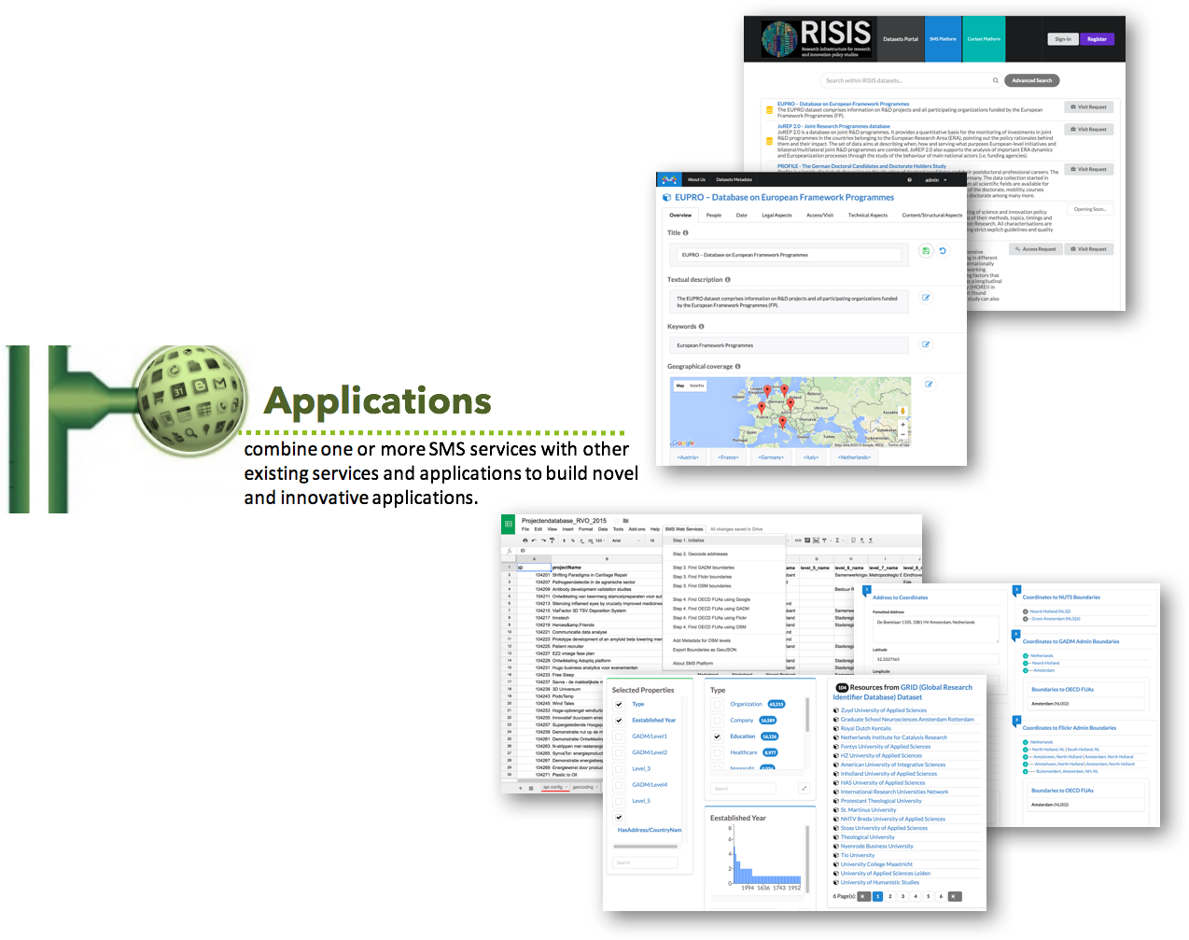
SMS Platform
Linked Data
Services
Applications
Less/Limited Services and Apps when data is not shared.
More Services and Apps when data is in Linked Data format.
Named Entity Recognition & Disambiguation
Metadata
Data Harmonization
Geo-enrichment
Interlinking
Semantically Mapping Science (SMS) Platform: http://sms.risis.eu
Notes:
This is to highlight that
Data in RDF can benefit from the services and applications available at RISIS.
In addition, the more a data is shared, the more your services and applications is can benefit from

Slide 17
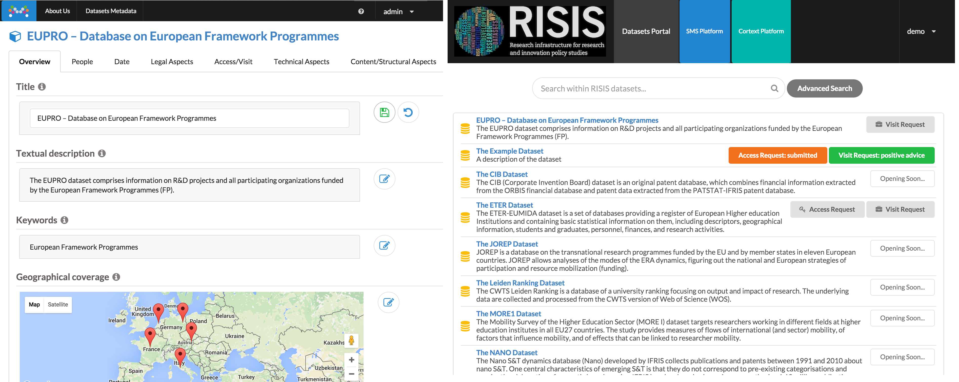
SMS Platform
Applications
Services
Metadata Editor
https://youtu.be/p_2D3ydcx1U?list=PLSBPxopOi20XPOn1sGBthbNtXIUOqM_4b
http://datasets.risis.eu
Semantically Mapping Science (SMS) Platform: http://sms.risis.eu

Slide 18
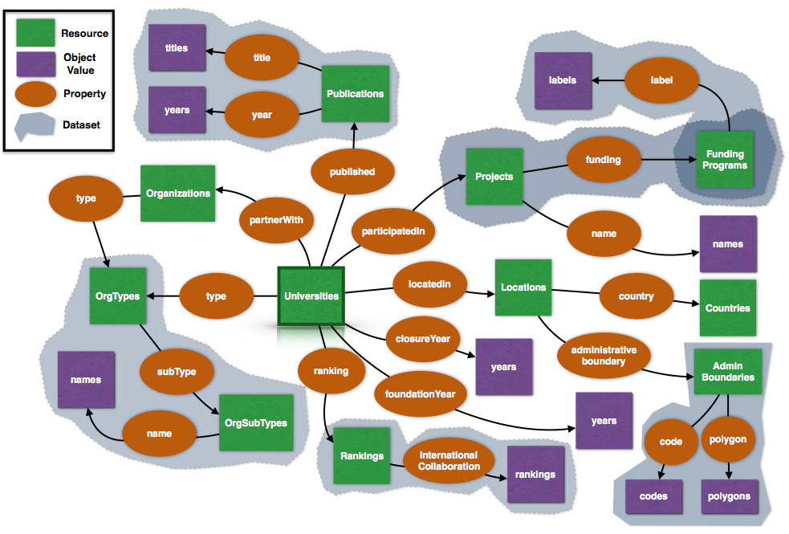
SMS Platform
Applications
Faceted Browser
Semantically Mapping Science (SMS) Platform: http://sms.risis.eu
Notes:
EXAMPLE OF NAVIGATION THROUGH LINK

Slide 19
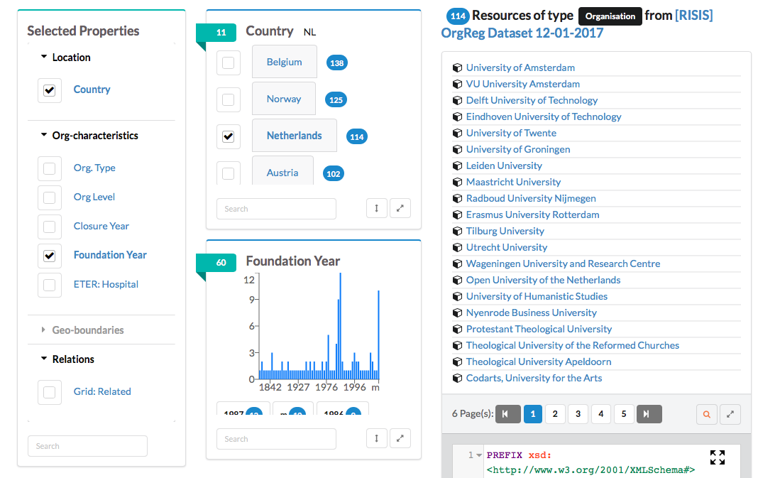
SMS Platform
Applications
Faceted Browser
Semantically Mapping Science (SMS) Platform: http://sms.risis.eu
Notes:
live demo with orgreg
Intuitively browse datasets

Slide 20
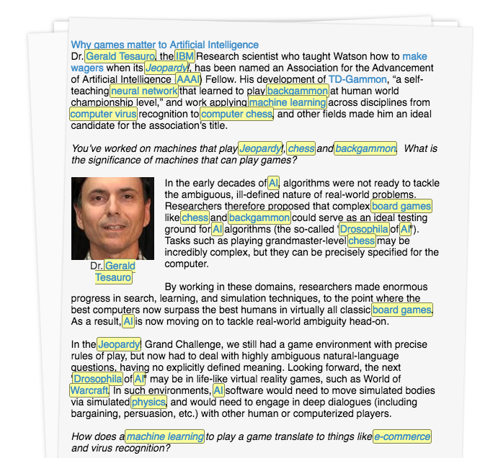
SMS Platform
Applications
Services
Named Entity Recognition
NER
Knowledge
Graph
Taxonomy
Semantically Mapping Science (SMS) Platform: http://sms.risis.eu
Notes:
Why?
explore
domain-specific tags
linking datasets

Slide 21
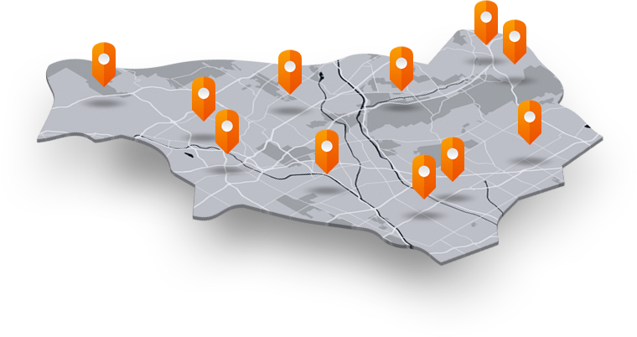
SMS Platform
Applications
Services
Geo-Enrichment
geocode
Address
Coordinates
Geo
Boundaries
Geo Statistical
Data
Administrative Boundaries
Funtional
Urban
Area
FUA
Semantically Mapping Science (SMS) Platform: http://sms.risis.eu

Slide 22
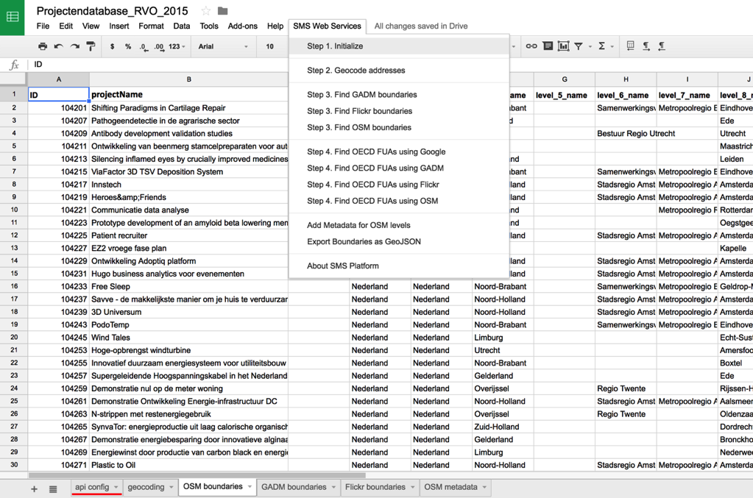
SMS Platform
Applications
Services
Google Spreadsheet Add-on
https://youtu.be/qZGDD5RN7pI?list=PLSBPxopOi20XPOn1sGBthbNtXIUOqM_4b
Semantically Mapping Science (SMS) Platform: http://sms.risis.eu

Slide 23
SMS Platform
Applications
Services
Interlinking
Use Global Unique Identifiers in your data as much as possible.
Semantically Mapping Science (SMS) Platform: http://sms.risis.eu

Slide 24
SMS Platform
Applications
Services
Interlinking
Schema/Data Alignment
Semantically Mapping Science (SMS) Platform: http://sms.risis.eu
Notes:
Which allows the creation contextual entity Linking in small steps.

Slide 25
SMS Platform
Applications
Services
Creating Linksets
Semantically Mapping Science (SMS) Platform: http://sms.risis.eu
Notes:
Create contextual entity Linking in small steps. That involves the creation of linksets, lenses and a view

Slide 26
SMS Platform
Applications
Services
Creating Lenses by combining Linksets
Semantically Mapping Science (SMS) Platform: http://sms.risis.eu
Notes:
Union set like operations
Such as UNION, INTERSECTION, DIFFERENCE and TRANSITIVITY lenses and a view

Slide 27
SMS Platform
Data
Architecture
Semantically Mapping Science (SMS) Platform: http://sms.risis.eu

Slide 28
SMS Platform
Any questions? comments?
Semantically Mapping Science (SMS) Platform: http://sms.risis.eu

